Slide 1
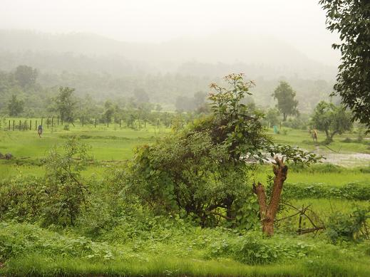
Impact India Foundation Community Health Initiative
Parali Primary Health Centre, Wada, Thane District, Maharashtra

Slide 2
Impact India Foundation Community Health Initiative Population: 60,000, mainly Tribals
Activities
April 2012 to July 2013

Slide 3
Community Capacity Building Soul of the Project
Training of CHI staff - 14 sessions
one session each month
Training of Government health staff: ASHAs, Anganwadi workers , Supervisors & ANMs by CHI staff
14 sessions for a batch of 225 persons per month.
Imparting of knowledge by Government staff to the
community – 26,707 attendees
Outcome: Increase in health awareness of local community

Slide 4
Information Education and Communication (IEC)
Impact India Foundation Community Health Initiative
Why?
Limited health knowledge in tribal population
Impact’s Role:
Educate and motivate local community and adolescents
1475 sessions & 47,072 attendees
Outcome:
Create Sustainability
Community should not have to rely on NGOs in the future

Slide 5
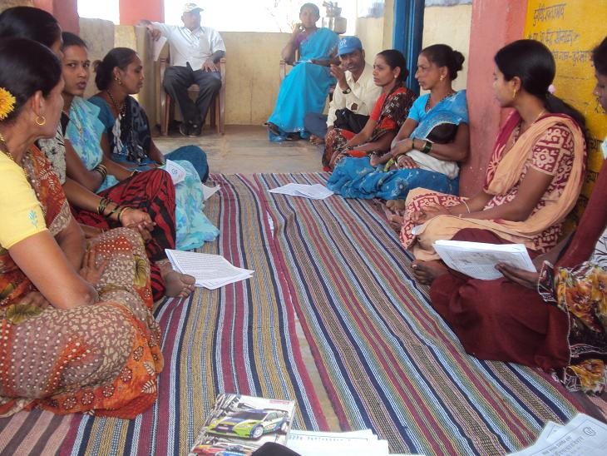
Impact India Foundation Community Health Initiative
Village Health Committees (VHCs)
Why ?
Participation and monitoring of village health activities
Impact’s role
Sensitize community on Government health programmes
and infrastructure
Outcome
- 26 VHCs functioning
- Creation of sustainability; establishing community-based monitoring
Community should not have to rely on NGOs in future.

Slide 6
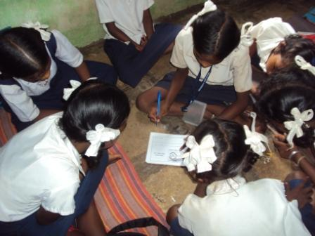
School Health Monitor Programme Screened children around 5980 children weekly by 598 school heath monitors
Impact India Foundation Community Health Initiative
Why?
Increase awareness on health and basic hygiene
in children
Impact’s role
Organizing and educating caregivers (Teachers, Parents, Anganwadi Sevikas)
Distribution of materials
Outcome
Health and hygiene awareness leads to significant
health improvement.

Slide 7
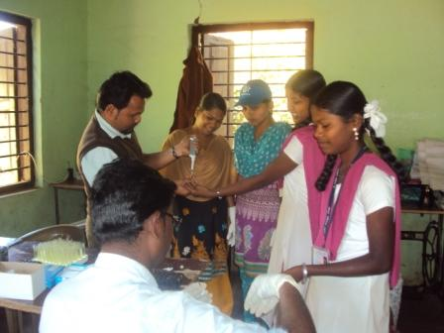
Anemia prevention mission- Hb Estimation
Impact India Foundation Community Health Initiative
Why?
Low Iron causes disability
60% girls with Haemoglobin (Hb) less than
10 g/dl at screening.
Impact’s role
Awareness, De-worming, Hb estimation (2878 girls)
Supply & consumption of IFA tablets,
Nutritional advice; Promotion of Home Gardens
(Seeds distributed 360 families)
Outcome
Increased Hb in potential mothers, decline in
Anemia;
Lower disability in their newborns;
Healthy future generations.

Slide 8
Impact India Foundation Community Health Initiative
Scale Up Nutrition (SUN)
Why ?
Adequate nutrition during pregnancy and the first two years of child is vital.
Impact’s role
Ante Natal Care, Anemia correction, Diet counseling.
Promotion of ‘Take Home Rations’ consumption, Promotion of exclusive breast-feeding, Counseling on weaning.
Outcome
Healthy age-related development of child.
Increased immunity, less disability, multiple positive benefits

Slide 9
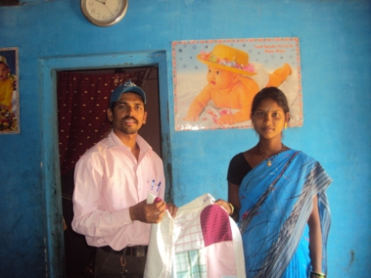
Impact India Foundation Community Health Initiative
Baby Wrap project
Why?
Prevent hypothermia in new born; promote
awareness on neo natal care
Impact’s role
Supply baby wrap to pregnant woman
in third trimester (934 baby wraps supplied);
promotion of institutional deliveries
Outcome
Reduce infant mortality and morbidity

Slide 10
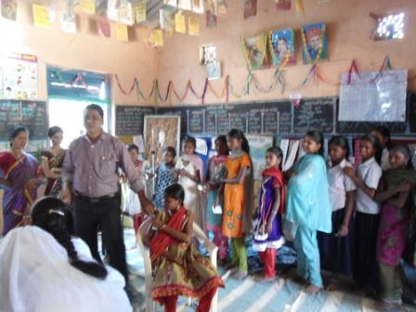
Rubella Immunisation
Impact India Foundation Community Health initiative
Why ?
German Measles also
causes disability in newborn
Impact’s role
Create community awareness on
Immunisation; Availability of vaccine
Outcome
200 adolescent girls vaccinated free of cost; with more to go.
Prevention of congenital disabilities

Slide 11
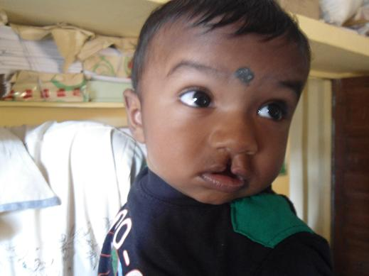
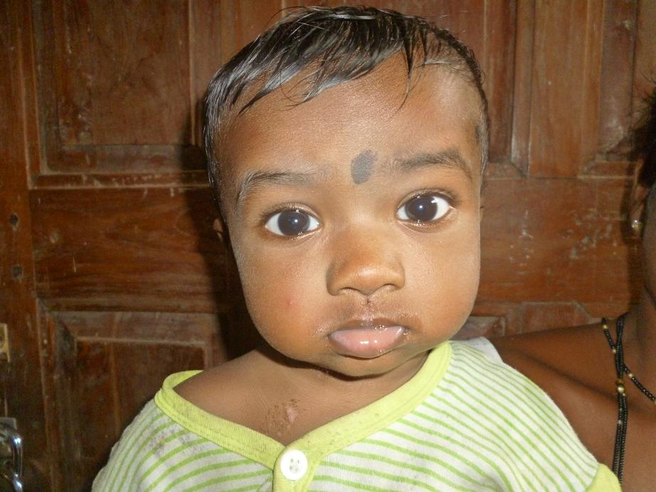
Curative
Impact India Foundation Community Health Initiative
Before & After
Cleft Lip Surgery
Why ?
Reduce existing disability
Impact’s role
Identify cleft and cataract cases and
physically challenged.
Correction of disability at apex hospitals
(130 persons availed services )
Outcome
Disabled brought into social stream

Slide 12
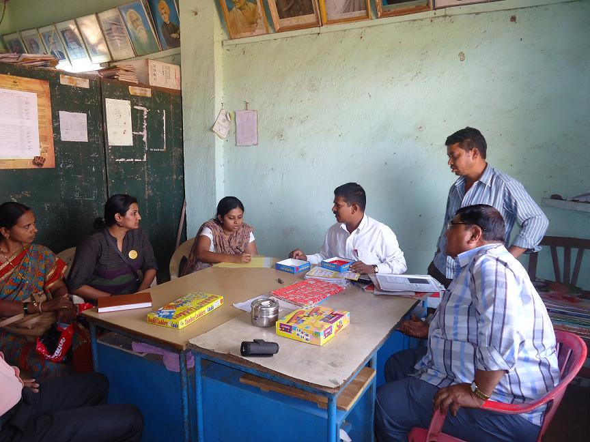
Toy Bank
Impact India Foundation Community Health Initiative
Why?
To develop interest in learning
among children; promote curricular and
social skills through games
Impact’s role
Partner with Toy bank
(5 Schools covered, 206 toys supplied)
Outcome
Enjoyable method of learning; well accepted by children and school authorities

Slide 13
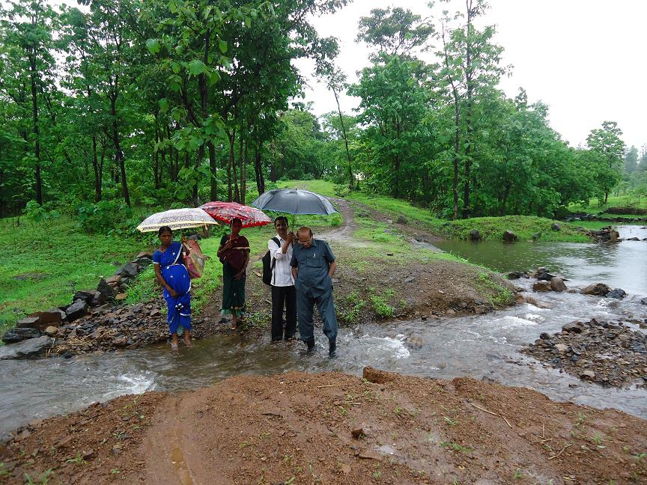
Promotion of institutional childbirths
Impact India Foundation Community Health Initiative
Why ?
Reduce IMR & MMR, prevent disability
Prevent morbidity in mothers
Impact’s role
Increase community awareness on advantages of
hospital deliveries and disadvantages and risks of home deliveries;
Motivate pregnant woman and decision makers by frequent counselling in remote
areas;
Facilitation of transport, function as care taker
Outcome
Institutional deliveries- 1122/1348 (83%)
Deliveries in PHC Parali- 2011-12 =90, 2012-13=124 ( IPHS sanction reverted)
Safe deliveries, timely referrals of high-risk pregnancies
Reduce IMR, MMR and avoid morbidity in mother & child .

Slide 14
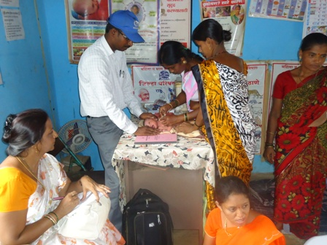
Immunisation
Impact India Foundation Community Health initiative
Why ?
Prevent disease rather than deal
with consequences;
Promote herd immunity
Impact’s role
134 Community Capacity Building sessions per month
to ensure community participation in immunisation;
Identify and motivate defaulters
Outcome
Increase number of people immunized (95% coverage)
Prevent disease and disability

Slide 15
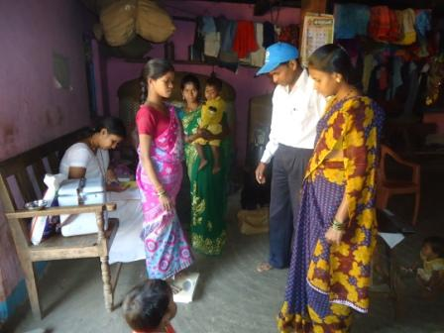
Ante Natal & Post Natal Care
Impact India Foundation Community Health Initiative
Why ?
Crucial to life long health
Prevent disabilities - Clefts, Spina Bifida and
Low Birth Weight babies prone to ill health
Impact’s role
Conduct 134 sessions per month,
Educate women on pregnancy, child birth
and childcare;
Diet counselling;
Ensure women seek medical help if needed
Outcome
Lower infant and Maternal mortality;
Less disability

Slide 16
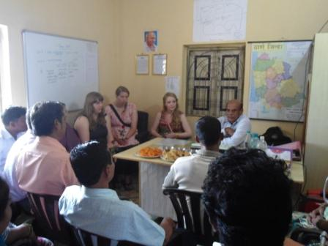
Visitors
Impact India Foundation Community Health Initiative
Why ?
Communicate field-based strategies,
learn international methods
Impact’s role
Welcome, facilitation of programme visits, guide medical electives and interns
Outcome
Feedback, suggestions, learnings, promotions and donations

Slide 17
Challenges
Impact India Foundation Community Health Initiative
Local migration: Large -scale migration in search of livelihood, after harvest.
Non availability of electricity: Restricts presentation of videos / slide shows . This detracts from the holistic education experience;
Upload of field data to an electronic system is a challenge.
False reporting: Government field staff misreport data. E.g- Noting home deliveries as hospital deliveries, Maternal deaths as normal deaths, short life births as still-births. See figures below:
Cont…
Year | Home delivery as per Government Health staff | Home delivery as per CHI staff
2012-13 | 194 | 242 (+48)
April 13 to July 13 | 103 | 200 (+97)
Contd …

Slide 18
Challenges
Impact India Foundation Community Health Initiative
Areas without roads and electricity 45 Villages /Padas (hamlets) in remote rural areas hamper health progress
Motivation of Govt. staff to complete assigned work on regular basis, including tracking of drop-out beneficiaries
Attendance of Govt. staff such as ASHAs, at healthcare orientation sessions by IIF continues to be poor due to lack of provision of TADA
Capacity Building of Government to internalise and prioritise CHI programmes is an uphill task.
Contd……

Slide 19
Challenges
Impact India Foundation Community Health Initiative
Motivating Government to personally interact with locals
Merely distributing pamphlets is not an IEC activity.
Community capacity building programme sessions are not built into the Govt.
health system.
Superstitions, societal & traditional pressures about health care continued to persist and are resistant to change
Community’s feeling of helplessness in demanding better health care services from the Government.
(26 empowered Village Health Committees demonstrate this can be overcome!)

Slide 20
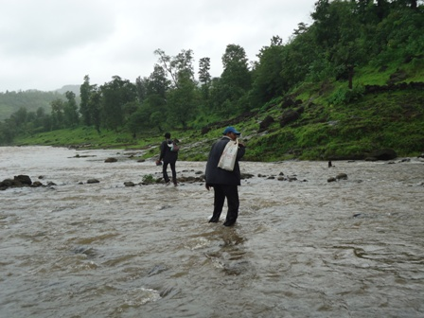
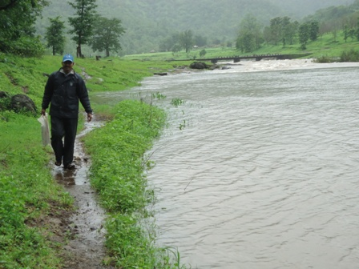
Impact India Foundation Community Health Initiative
Thank You !
CHI staff traversing long distances, through flooded streams, to track pregnant and new mothers at Bhagatpada, Ujjaini Sub Centre, Wada.

